Slide 1

CYBERSQUATTING

Slide 2
What is Cybersquatting?
Cybersquatting, also known as domain squatting, involves bad faith registration of domain names. The intention is to sell or use them for profit. This often targets trademarks and well-known brand names. It's a form of trademark infringement.
Registering domain names to profit.
Targets trademarks.
Trademark infringement.

Slide 3

Types of Cybersquatting
Typosquatting
Exploiting misspellings of popular domains.
Brandjacking
Registering domains resembling existing brands.
Namejacking
Using personal names in domain registrations.
Domain Speculation
Registering generic domains for resale.

Slide 4


Typosquatting
Misspellings
Exploits common misspellings.
Redirection
Redirects to malicious sites.
Typosquatting exploits common misspellings of popular domains. For example, using "gooogle.com" instead of "google.com." It redirects users to malicious sites .

Slide 5




Brandjacking
Resemblance
1
Damage
2
4
Diversion
3
Counterfeit
Brandjacking involves registering domains that closely resemble existing brands. "coca-cola-shop.net" instead of "coca-cola.com" is an example. It damages brand reputation, diverts traffic, and sells counterfeit products.

Slide 6




Namejacking
Personal Names
Targets personal names.
Public Figures
Targets celebrities.
Privacy Risks
Poses privacy risks.
Namejacking involves registering domain names that contain personal names. It often targets celebrities, politicians, or public figures. Registering "elonmusk.com" before Elon Musk does is an example. It poses privacy and reputational risks.

Slide 7



Domain Speculation
1
Profit
2
Resell
3
Generic
Domain speculation, also known as "domaining," involves investing in domain names with the intention of selling them for a profit, often by identifying valuable or trending names and registering them before others. For Example wallstreet.com: Registered for $70 in 1994 and sold for $1 million in 1999.

Slide 8
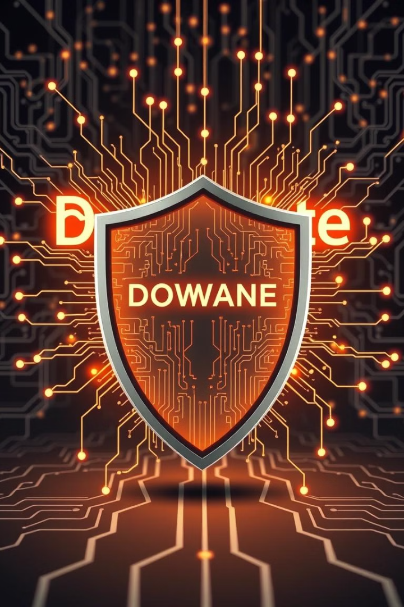
Cybersquatting Prevention
Trademark Registration
Internet Monitoring
Register trademarks as domain names.
Monitor the Internet for unauthorized trademark use.
Legal Action
Take action against cybersquatters.
To prevent cybersquatting, companies and individuals should register trademarks as domain names. Monitoring the Internet for unauthorized trademark use is essential. Legal action against cybersquatters is also needed to protect digital identities.

